Slide 1
NAMED ENTITY RECOGNITION

Slide 2
Supervisor’s Name- Dr. Rakesh Kanji Group Members Batch-CS63
Name-Aanchal Thakur Name-Kartik Bohra Name-Anurag
Rollno-181285 Rollno-181289 Rollno-181278

Slide 3
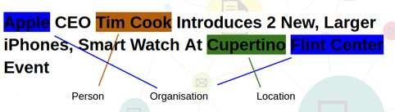
BUT WHAT BASICALLY IS A NAMED ENTITY?
Word or Phrase that identifies one item from a set of items that have similar attributes
Semantic elements that carry a meaning
Named Entities with their labels are recognized as follows:
ENAMEX : Person(Tim Cook) , Organization (Apple , Flint Center), Location(Cupertino)
TIMEX : Date , Time
NUMEX : Money , Percentage , Quantity
o Named Entities are either dependent on the Proper Names tagging or on the Part Of Speech (POS ) tagging.

Slide 4
Named Entity Recognition (NER)
Named Entity Recognition is used in many fields in Natural Language Processing (NLP), and it can help answering many real-world questions.
Named entity recognition(NER) is probably the first step towards information extraction that seeks to locate and classify named entities in text into pre-defined categories such as the names of persons, organizations, locations, expressions of times, quantities, monetary values, percentages, etc.
Information comes in many shapes and sizes.
One important form is structured data, where there is a regular and predictable organization of entities and relationships.

Slide 5
Named Entity Recognition
Natural language processing is a sub-area of computer science, information engineering, and artificial intelligence concerned with the interactions between computers and human (native) languages. This is nothing but how to program computers to process and analyse large amounts of natural language data.
NLP = Computer Science + AI + Computational Linguistics
Another way, Natural language processing is the capability of computer software to understand human language as it is spoken. NLP is one of the component of artificial intelligence (AI).

Slide 6

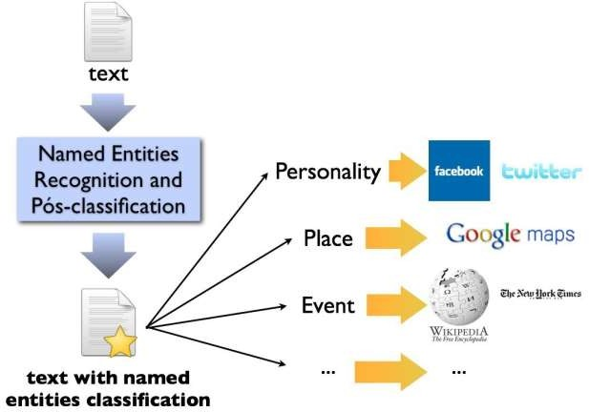
TYPES OF NAMED ENTITIES
GENERIC NE:
Includes names of persons , organizations,
etc.
For Example, any general requirement consisting of names of persons, organization
, URLs, Location and so on.
DOMAIN SPECIFIC NE: Consists of entities related to domains For example,
In a medical domain, names of diseases , names of medicines form the entities whereas
In a manufacturing domain names of products , manufacturers , attributes of products form the named entities.

Slide 7
Models and Libraries used in the project
Models
LSTM
BERT
Libraries
Spacy
simpleTransformer
LabelEncoder
train_test_split
accuracy_score

Slide 8
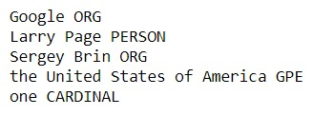
INPUT AND OUTPUT OF NER
OUTPUT
example = "Google, a company founded by Larry Page and Sergey Brin in the United States of America "\+ "has one of the world’s most advanced search engines."
INPUT

Slide 9
WHAT ACTUALLY HAPPENS!
PART OF SPEECH TAGGER
SENTENCE SLPITTER
TOKENIZER
NER
SEMANTIC TAGGER
GAZETTEER

Slide 10
Some Important Terms
Tokenization-Segmenting texts into word, punctuations marks, etc .
Part-of-Speech Tagging- Assigning word types to tokens, like verb or noun.
Gazetteer-It works as speacialized Dictionaries to support initial tagging.
Semantic Tagger-It analyses your text, extract concepts ,identifies topics and disambiguates similar entities.
NER-Named Entity Recognition helps in labelling named “real world” objects like persons, company or location.

Slide 11
Implementation
using LSTM model

Slide 12
LSTM Model
Task-1 -> Import Modules.
Task-2 -> Load and Explore NER Dataset.
Task-3 -> Visualizing the sentence.
Task-4 -> Retreive Sentences and Corespondiong Tags.
Task-5 -> Define mapping between sentences and tags
Task-6 ->Padding Input Sentences and Creating Train/Test Splits.
Task-7 -> Build and Train the model.
Task-8 -> Evaluate named Entity Recognition.

Slide 13
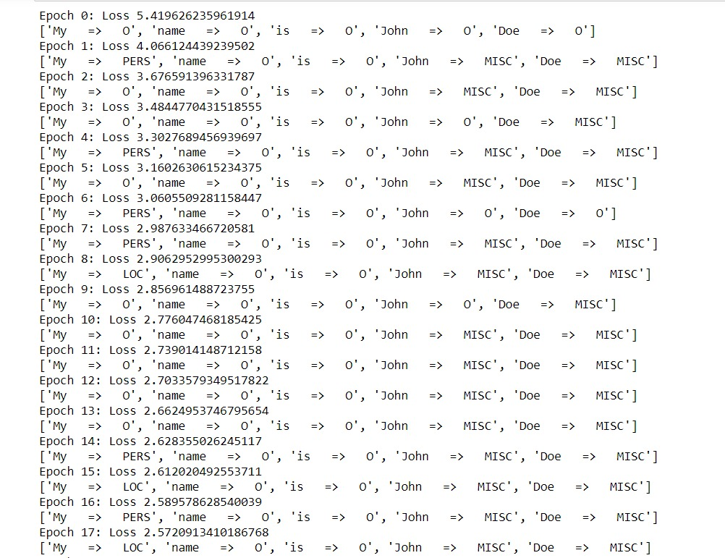
OUTPUT

Slide 14
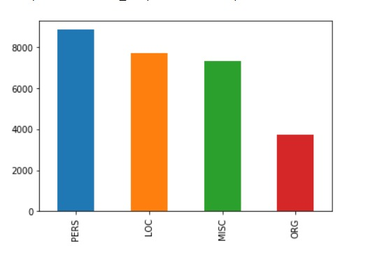
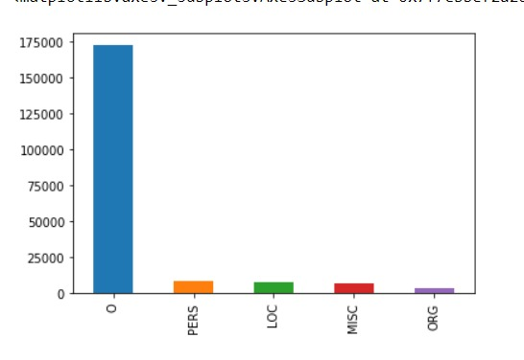
Comparison

Slide 15
Spacy
It provides an exceptionally efficient Statistical system for NER which can assign labels to group of tokens which are contiguous . It provides a default model which can recognize a wide range of named or numerical entities, which include person, organization, language,event etc.

Slide 16
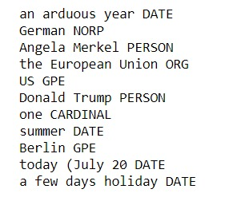
example ="It’s been an arduous year for German chancellor Angela Merkel, so far. "\+ "She has battled through coalition negotiations to form a government, chivvied "\+ "the European Union into a loose agreement on migrants, weathered insults from "\+ "US president Donald Trump, and headed off a revolt from her interior minister. No wonder "\+ "then one journalist at her summer news conference in Berlin today (July 20) asked if "\+ "she was, honestly, just exhausted. “I can’t complain,” Merkel said, “I have a few days "\+ "holiday now and am looking forward to sleeping a bit longer.”"
INPUT
OUTPUT

Slide 17
Implementation
using BERT

Slide 18
Bert Model
Load dataset.
Set Data into training embeddings(included pre-processing ,setting of arguments, labels).
Train model.
Evaluate model performance.

Slide 19
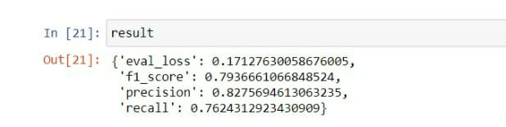
Implementation
We will convert the problem into a sequence labeling task where the objective is to learn the tags for the tokens. We will be using the “bert-base-cased” variant of BERT as it is more suited for the NER task.
Our test set will be a list of sentences with manually annotated tags and we will be comparing the scores from the two models as our comparison metric.
We wish to contrast how BERT and LSTM are trained on the task and the kind of scores the produce at the time of training on a general as well domain-specific NER.

Slide 20
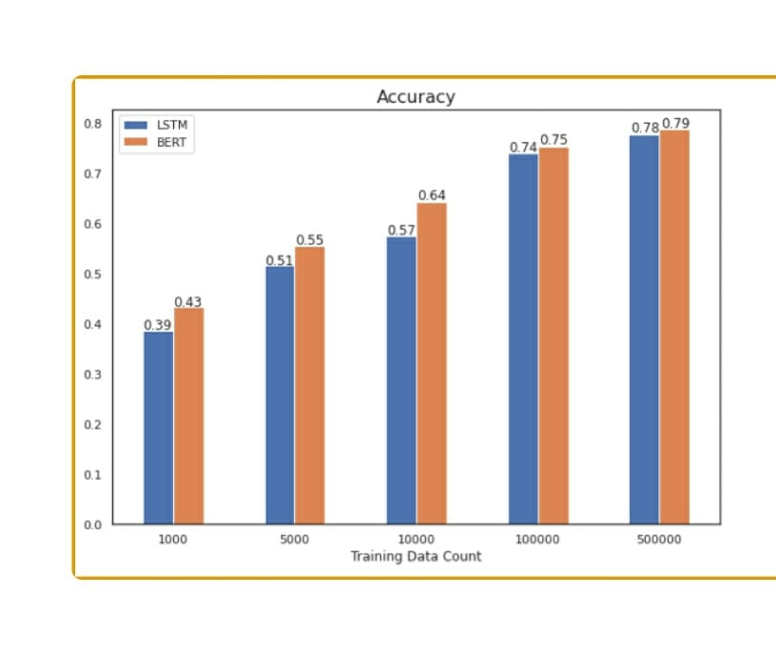
Comparing the result
BERT performed a little better than LSTM but no significant difference when the models are trained for same amount of time.

Slide 21
Reference
Link of Dataset
https://github.com/dice-group/FOX/tree/master/input/Wikiner
https://www.kaggle.com/abhinavwalia95/entity-annotated-corpus/ entity-an
Nadeau, D., & Sekine, S. (2007). A survey of named entity recognition and classification. Jbe platform. https://doi.org/10.1075/li.30.1.03nad
Ratinov, L., & Roth, D. (2009). Design challenges and misconceptions in named entity recognition. In Proceedings of the Thirteenth Conference on Computational Natural Language Learning. aclweb.org. https://www.aclweb.org/anthology/W09-1119.pdf
Ritter, A., Clark, S., & Etzioni, O. (2011). Named entity recognition in tweets: an experimental study. aclweb.org. https://www.aclweb.org/anthology/D11-1141.pdf

Slide 22

Future scope

Slide 23
AUTOMATIC RETRIEVAL OF DATA
RETRIEVAL OF RELEVANT DATA FROM THE WEB

Slide 24
Workflow Chart
January
Febuary
March
A literature survey on named entity recognition
Worked on LSTM Model
Worked on spacy
April
May
Worked on Bert Model
Summed up

Slide 25
